Slide 1

Factors Predicting Depression Rate
Jonathan Gordon, Timothy Kelly, Kevin Koelsch, & Phillip Kudryavtsev

Slide 2
Depression is a common mental disorder
Approximately 280 million people in the world have depression.
During a depressive episode, a person experiences a depressed mood (feeling sad, irritable, empty). They may feel a loss of pleasure or interest in activities.
Depression can cause difficulties in all aspects of life, including in the community and at home, work and school.

Slide 3

Our aim is to determine factors which influence the rate of depression in Massachusetts communities and recommend actions which can reduce depression in these communities.
This can only be done with data.

Slide 4
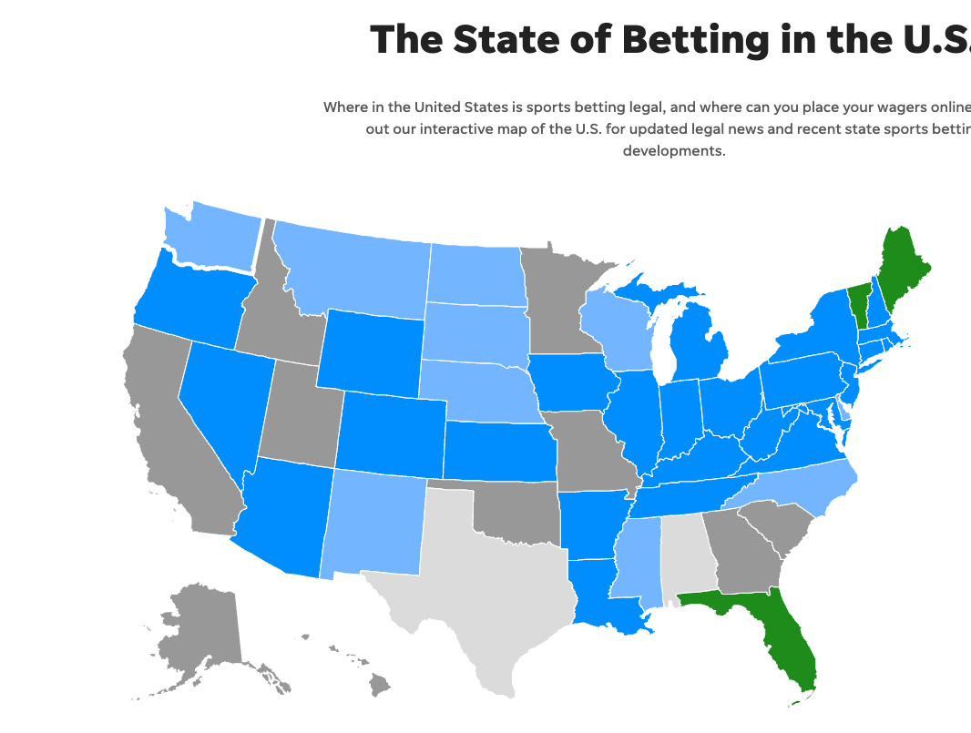
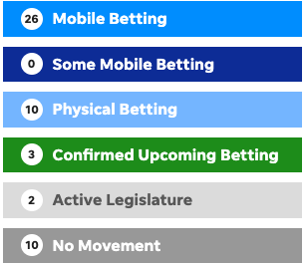
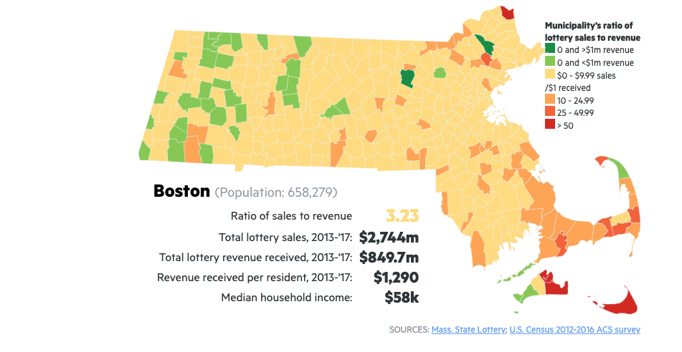
Project Overview
Mass State Lottery
USA Today

Slide 5
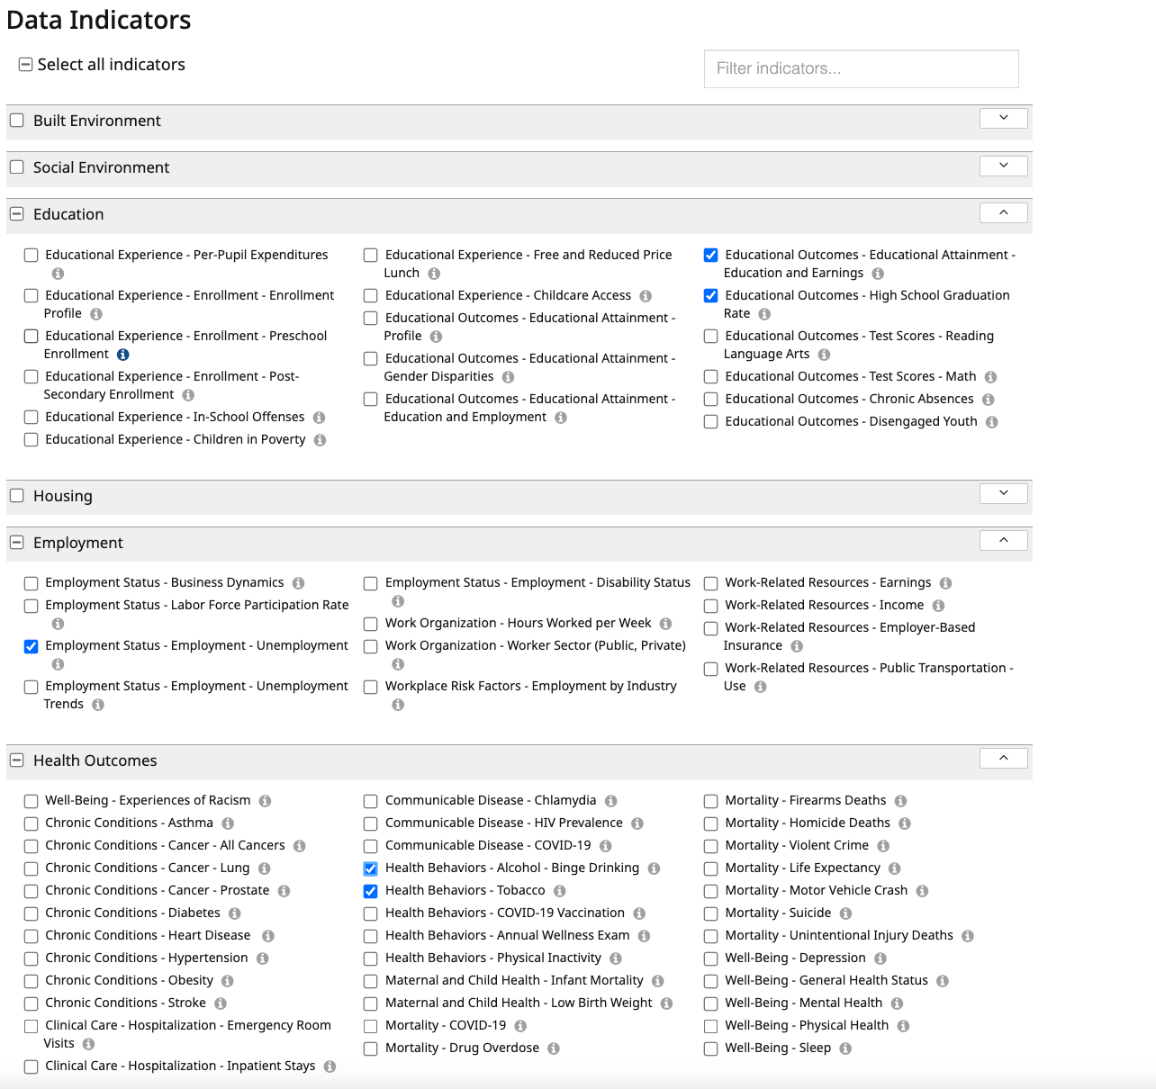
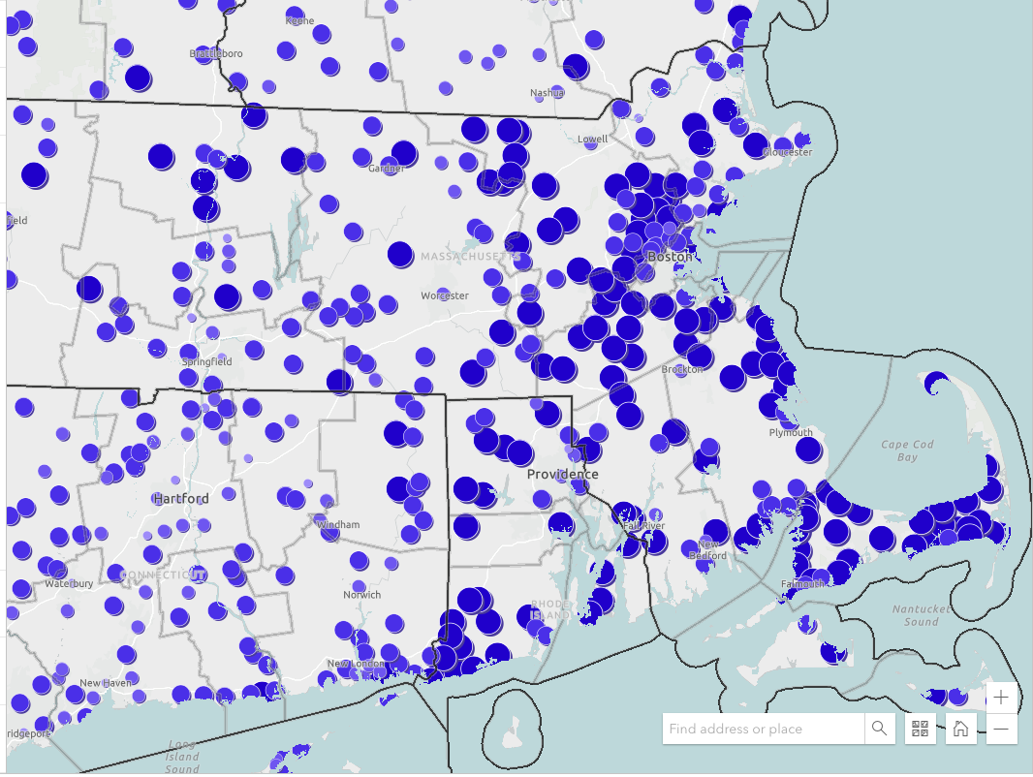
Health Indicators
Binge drinking 2021
https://www.mass.gov/info-details/community-health-data-tool

Slide 6
The Community Health Data Tool Contains millions of data points on the health of citizens throughout the Commonwealth. Of prominent interest to us in our initial analysis were those listed here
Data Label | Data Description
City | Name of town or City
MedInc | Median Individual Income of City from state lottery
Unemploy | Unemployment % by City
Binge | % of City population engaged in binge drinking (5 drinks in one sitting)
Smoke | % of City population who smoke (current smoker)
Obesity | % of City population with BMI >= 30%
Depress | % of City population who are depressed
MedHouseInc | Median Household Income of City
LTHS | % of population in City who did not complete High School
HS | % of population in City who graduated High School, but did not pursue higher education
SomeColl | % of population in City who attended College, but did graduate
College | % of population in City who graduated College, but did not pursue advanced education
2022LottoSales | 2022 Calendar Year MA Lottery Sales by City/Town
LottoSalesPerCapita | 2022LottoSales ÷ Pop25Plus

Slide 7

Reduced Data Set and Contextual Analysis
Dependent Variable: Depression
Independent Variables
Achievement: Median Household Income, No High School, High School, Unemployment
Health related: Obesity, Binge Drinking, Smoking
Dropped Variables:
Some College and College – Correlated with high school variables
Pop, Pop25 – used for calculating lottery / capita
Lottery Sales – early models showed little correlation
Median Individual Income – correlated to Household income

Slide 8
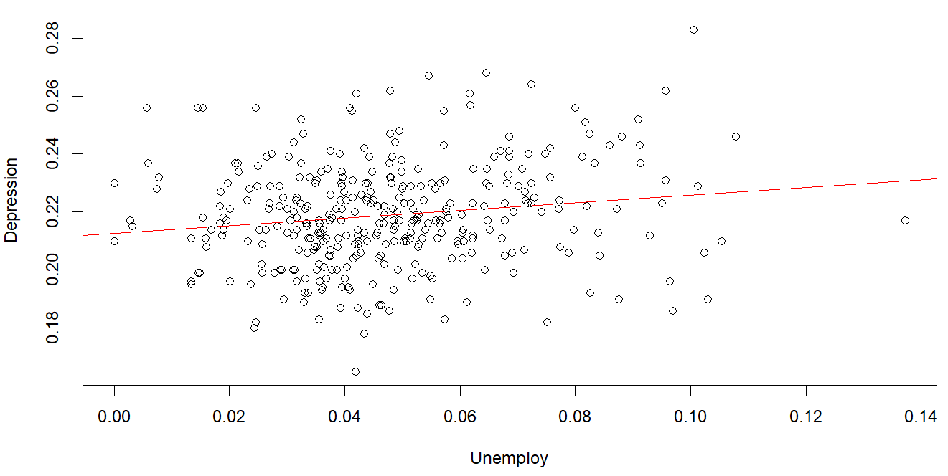
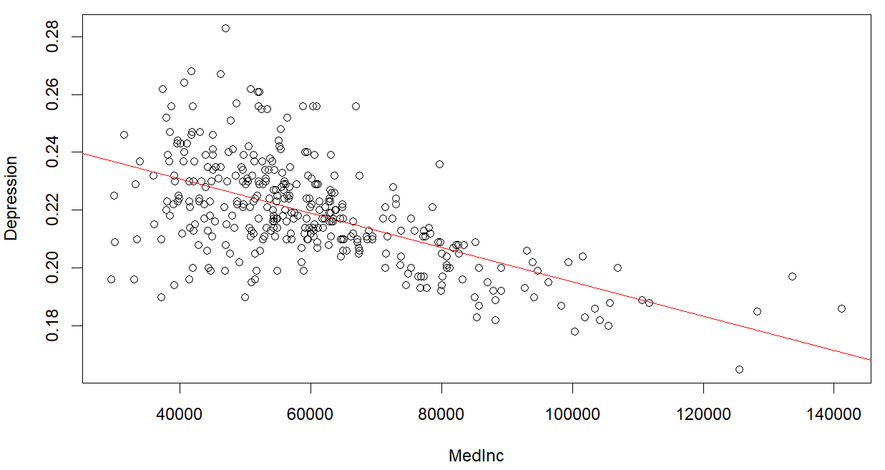
Simple Linear Models
To complement our contextual hypotheses, we plotted each independent variable against the dependent variable to visualize the individual relationships.
We looked at the shape of the graph to determine:
Whether a relationship exists?
What does that relationship look like? (i.e. linear, parabolic, etc.)
The unemployment graph (top) shows an almost flat relationship which indicates minimal predictive capability from unemployment rate.
Conversely, the MedInc graph (bottom) shows a clear linear relationship in the negative direction. As medium house income increases, depression rate decreases.

Slide 9
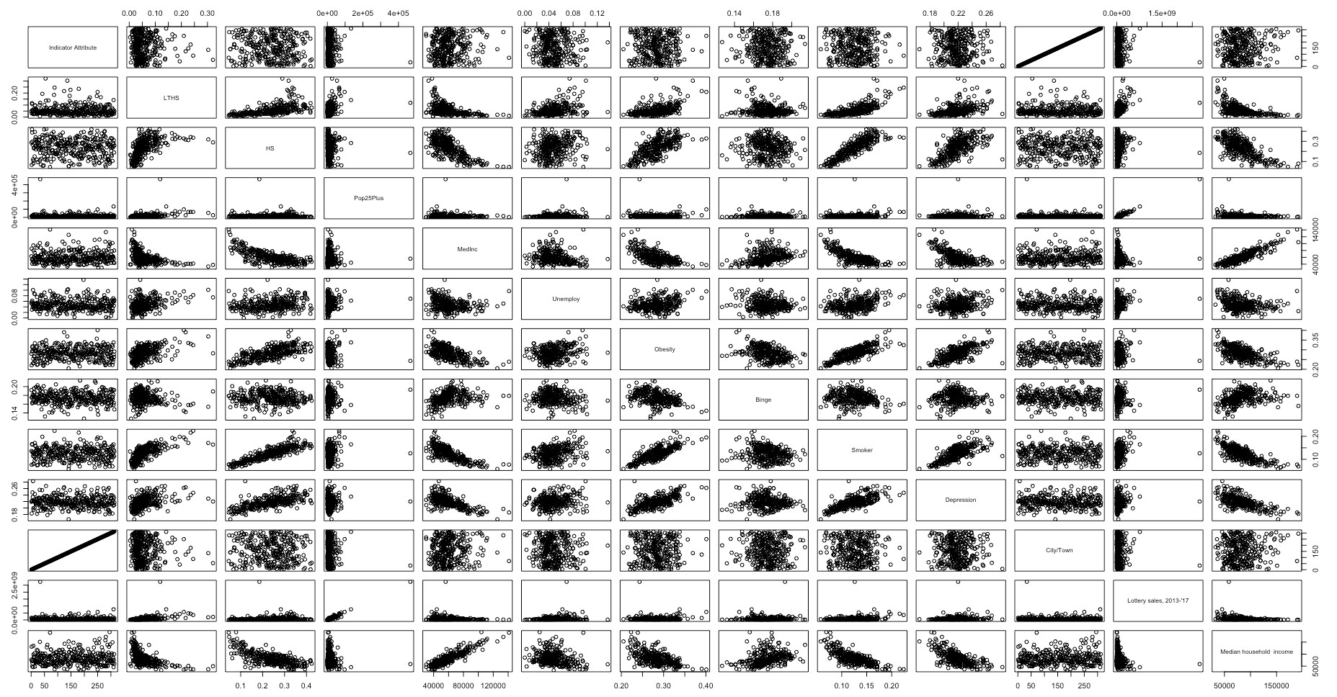
Addressing Multicollinearity
Before Testing Multiple Regression Models, it was important to understand how well our independent variables were able to predict each other
Upon inspection some variables exhibited multicollinearity which were not entirely expected
Being aware of multicollinearity is important as we test and examine different models especially when considering which variables to include or remove

Slide 10
Multiple Regression Modeling
Multiple Regression Modeling was an iterative process. We first incorporated all of our previously identified meaningful variables. We gradually reduced the number of variables to optimize predictability in an interpretable manner.
Adjusted R squared increased significantly in Multiple Regression modeling in comparison to any Simple Linear model.
Higher order variables were extensively analyzed but largely eroded R-Squared in comparison to our best Multiple Regression Models.

Slide 11
We initially arrived at this regression equation: ŷ = 0.095 + 0.299x₁ + 0.357x₂ - 2.8e⁻⁷x₃ (y = Depress, x1 = Obese, x2 = Binge, x3 = MedHouseInc) Global F test and all independent variables had strong evidence of statistical significance. Adj R^2 value of 0.6228 However, depression levels are likely experiencing % changes due to fluctuations in the independent variables as opposed to absolute changes so we tested transforming the model to a logarithmic function...
Results
… We re-wrote the model, arriving at this equation:
ŷ = 10.976 * 1.018^{x1} * 1.016^{x2} * .9999989^{x3} (y = Depress %, x1 = Obese %, x2 = Binge %, x3 = MedHouseInc) Global F test and all independent variables had strong evidence of statistical significance. Adj R^2 value of 0.647

Slide 12
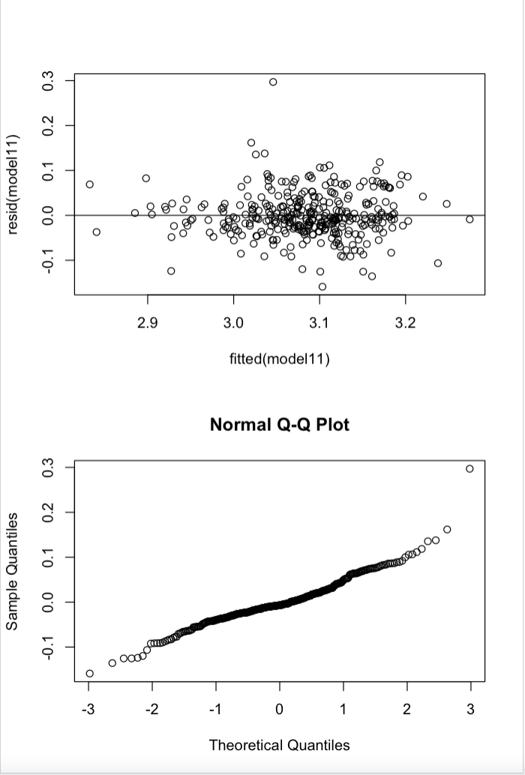
Validation on Assumptions of Random Error and Residual Analysis
The mean of the residuals appears to be 0 from inspecting the residual plot
The residual plot does show residuals slightly more spread out on the right, but the constant variance assumption appears to hold up
QQ Plot shows strong evidence of normal distribution
DWT – little evidence of auto correlation
DWT | lag Autocorrelation | D-W Statistic | Statistic p-value
1 | 0.07413602 | 1.850624 | 0.204

Slide 13
Recommendations off results to Massachusetts Cities
Decrease Alcohol Consumption in communities through taxation
Promote Active Lifestyles via nutrition education and consider subsidizing health and wellness oriented community centers
Note: The effectiveness of these recommendation in driving down depression has not been tested in the course of this project. As our model predicts that Increased rates of Binge Drinking and increase rates of Obesity in a community serve to increase the rate of Depression, we have hypothesized solutions to reduce these factors. Increase Median Household Income, based on our model, would also serve to reduce rates of depression, however the variables affecting Median Household Income are more nuanced and thus we at this time cannot provide recommendations to increase Median Household Income to reduce Rates of Depression in Massachusetts communities

Slide 14
Future Exploration
Testing cause and effect between different relationships observed:
Ex. Does Depression lead to binge drinking or does binge drinking lead to Depression
Expanding analysis inclusive of additional variables to further account for variations in observed data.
Ex. Isolation, prior health conditions, traumatic events, etc.
Testing Recommendations for effectiveness in reducing depression in communities.
Isolating communities with recommended policies and services and see if there a statistically significant decrease in rates of depression.

Slide 15
Q&A

Slide 16
Backup

Slide 17
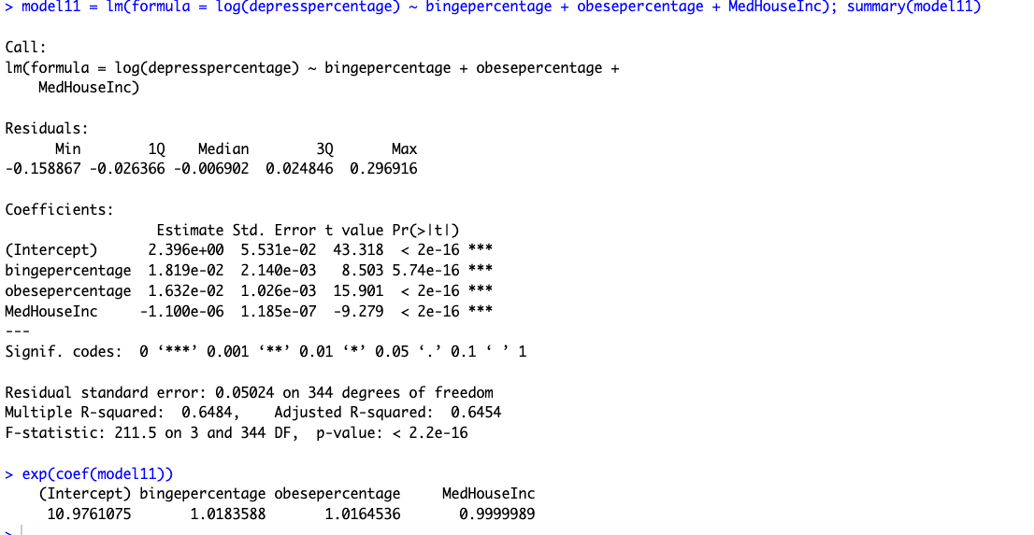
Model Output

Slide 18
Sources Leveraged in Presentation
https://www.who.int/news-room/fact-sheets/detail/depression
https://www.mayoclinic.org/diseases-conditions/depression/diagnosis-treatment/drc-20356013#:~:text=Medications%20and%20psychotherapy%20are%20effective,or%20other%20mental%20health%20professional.
https://www.cdc.gov/policy/hi5/alcoholpricing/index.html#:~:text=There%20is%20strong%20scientific%20evidence,alcohol%20consumption%20and%20related%20harms.
https://www.mass.gov/info-details/community-health-data-tool

